Slide 1
Squere-free integers
Project Team
No. | Name. | University Id
1 | Fahad Mohammad ALGHOFAILI
2 | Mohammed Abdullah Aldawsari

Slide 2
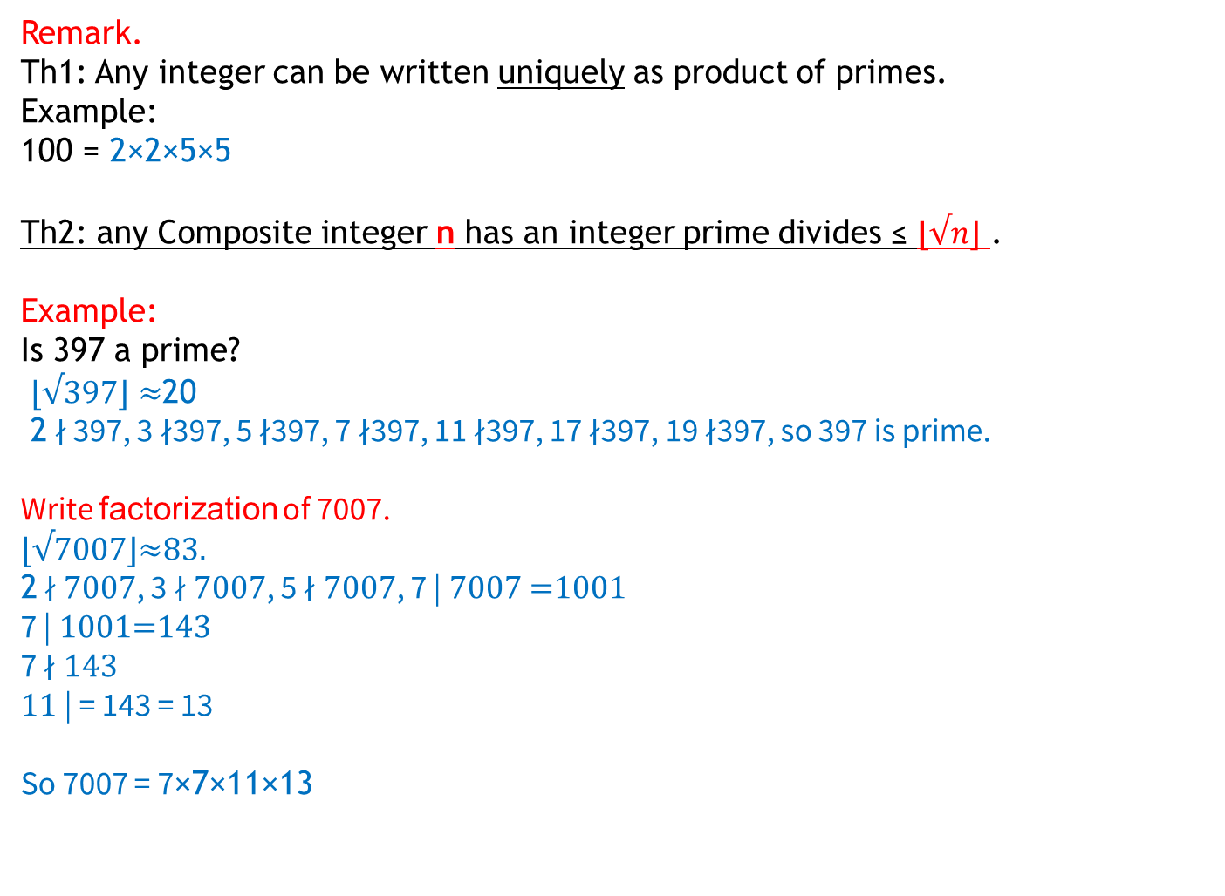
Remark.
Th1: Any integer can be written uniquely as product of primes.
Example:
100 = 2×2×5×5
Th2: any Composite integer n has an integer prime divides ≤ $⌊√n⌋$ .
Example:
Is 397 a prime?
$⌊√397⌋≈$20
2 ∤ 397, 3 ∤397, 5 ∤397, 7 ∤397, 11 ∤397, 17 ∤397, 19 ∤397, so 397 is prime.
Write factorization of 7007.
⌊√7007⌋≈83.
2 ∤ 7007, 3 ∤ 7007, 5 ∤ 7007, 7 | 7007 =1001
7 | 1001=143
7 ∤ 143
11 | = 143 = 13
So 7007 = 7×7×11×13

Slide 3
Definition.
square-free integer (or squarefree integer): is an integer which is divisible by no square number other than 1, its prime factorization has exactly one factor for each prime that appears in it.
Example1.
10=2×5
70 = 2×5×7
So 10,70 are square-free.
Example 2.
18 = 2×3×3=2×3^2. not square-free.

Slide 4
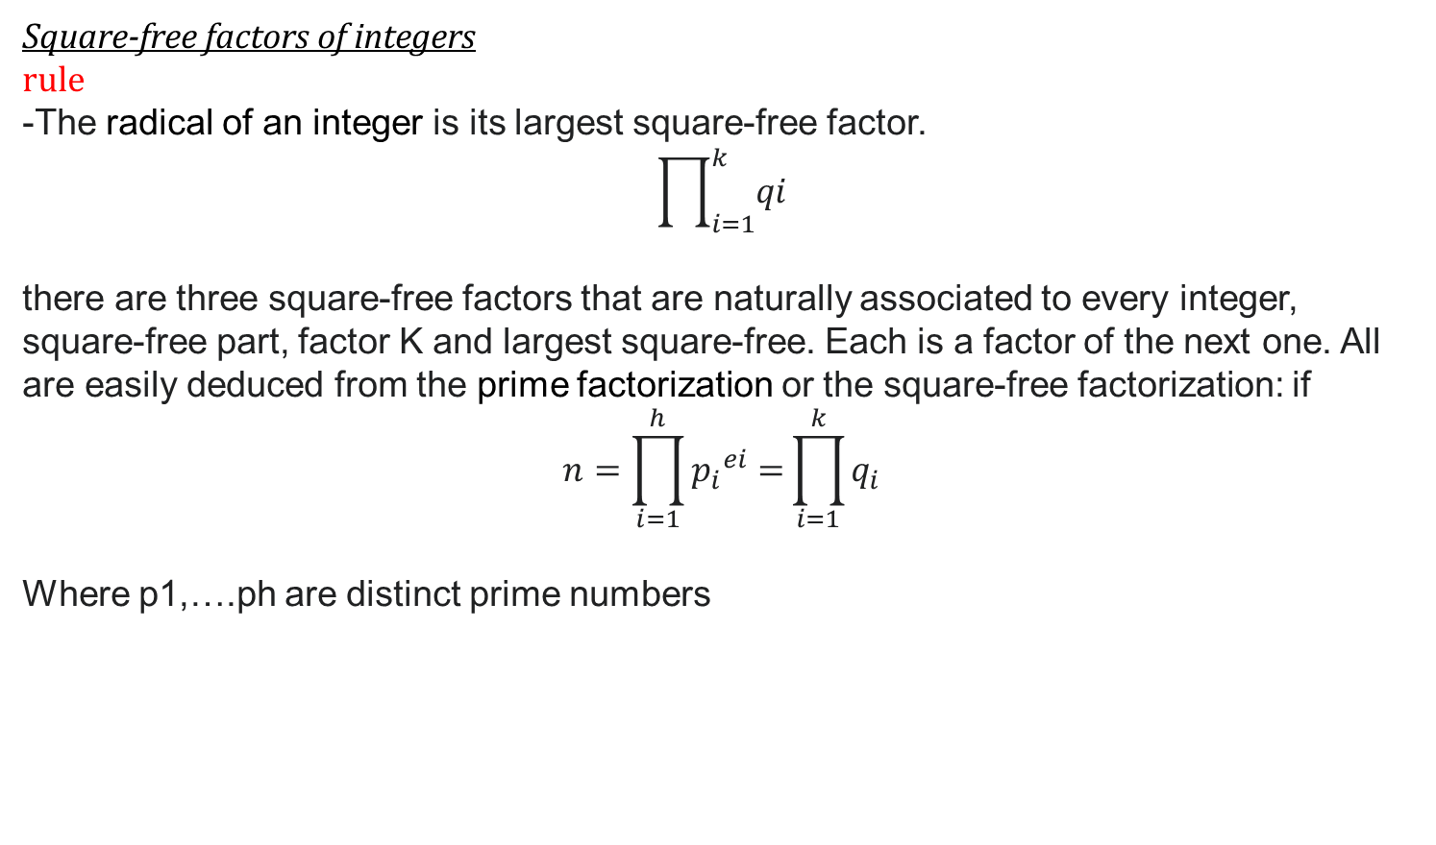
Square-free factors of integers
rule
-The radical of an integer is its largest square-free factor.
$$\prod_{i=1}^{k}{qi}$$
there are three square-free factors that are naturally associated to every integer, square-free part, factor K and largest square-free. Each is a factor of the next one. All are easily deduced from the prime factorization or the square-free factorization: if
$$n=\prod_{i=1}^{h}{{p_{i}}^{ei}=}\prod_{i=1}^{k}{q_{i}}$$
Where p1,….ph are distinct prime numbers

Slide 5

1-square-free part
$$\prod_{ei=1}{pi=q1}$$
2- The square-free factor such the quotient is a square
$$\prod_{e1 odd}{p_{i}}=\prod_{i odd}{q_{i}}$$
3- largest square-free
$$\prod_{i=1}^{h}{pi}=\prod_{i=1}^{k}{qi}$$
Example1:
If n = 75600 = $2^{4}×3^{3}$ $×5^{2}$ $×7$
$q_{1}=7,q_{2}=5,q_{3}=3,{ q}_{4}=2$
the square-free part is 7,
the square-free factor such that the quotient is a square is 3 $×$ 7=21.
the largest square-free factor is 2 $×$ 3 $×$ 5 $×$ 7 = 210.

Slide 6
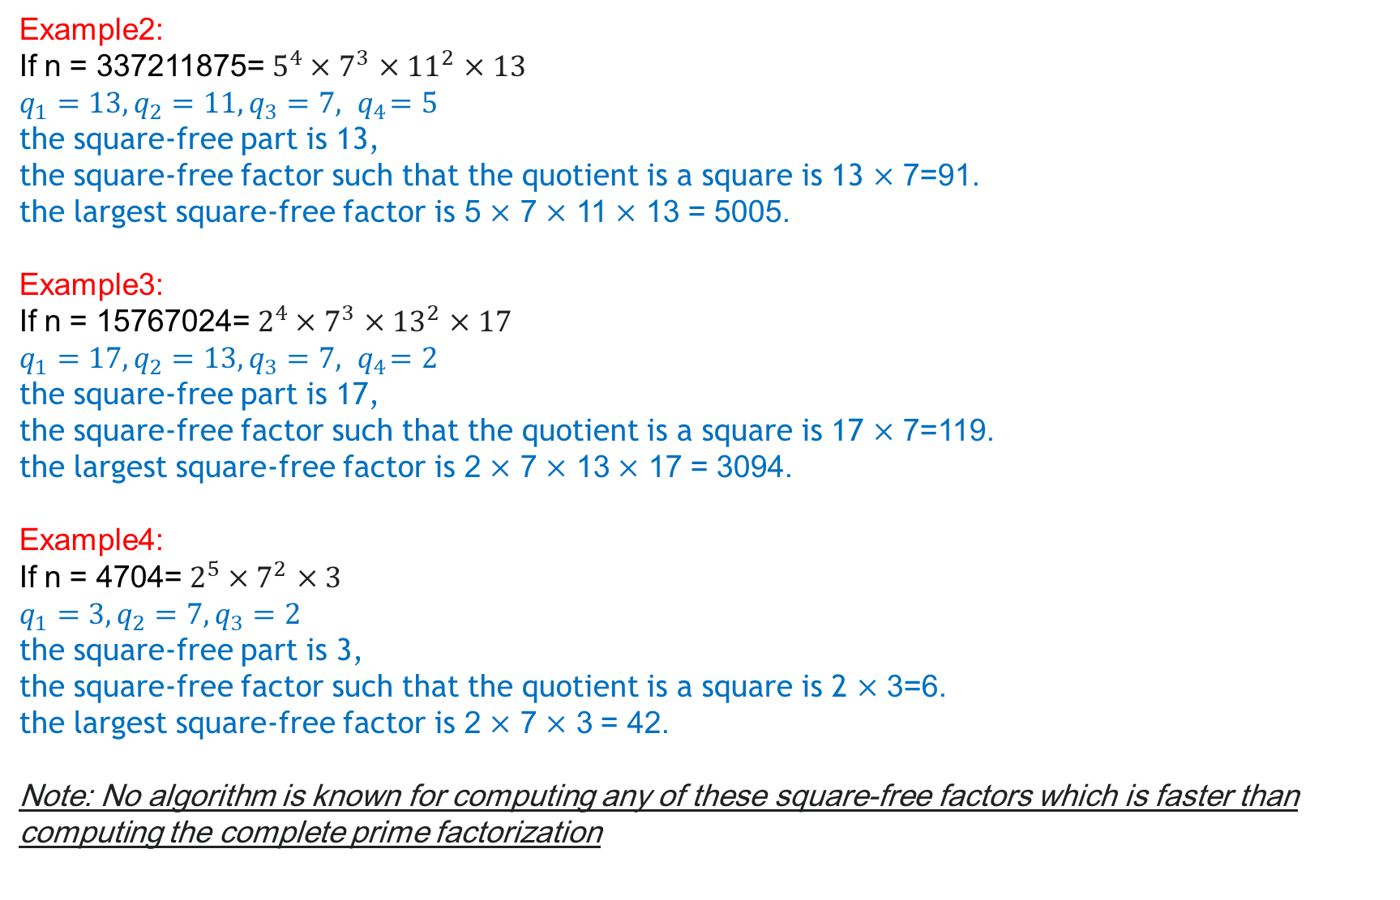
Example2:
If n = 337211875= $5^{4}×7^{3}$ $×{11}^{2}$ $×13$
$q_{1}=13,q_{2}=11,q_{3}=7,{ q}_{4}=5$
the square-free part is 13,
the square-free factor such that the quotient is a square is 13 $×$ 7=91.
the largest square-free factor is 5 $×$ 7 $×$ 11 $×$ 13 = 5005.
Example3:
If n = 15767024= $2^{4}×7^{3}$ $×{13}^{2}$ $×17$
$q_{1}=17,q_{2}=13,q_{3}=7,{ q}_{4}=2$
the square-free part is 17,
the square-free factor such that the quotient is a square is 17 $×$ 7=119.
the largest square-free factor is 2 $×$ 7 $×$ 13 $×$ 17 = 3094.
Example4:
If n = 4704= $2^{5}×7^{2}$ $×3$
$q_{1}=3,q_{2}=7,q_{3}=2$
the square-free part is 3,
the square-free factor such that the quotient is a square is 2 $×$ 3=6.
the largest square-free factor is 2 $×$ 7 $×$ 3 = 42.
Note: No algorithm is known for computing any of these square-free factors which is faster than computing the complete prime factorization

Slide 7
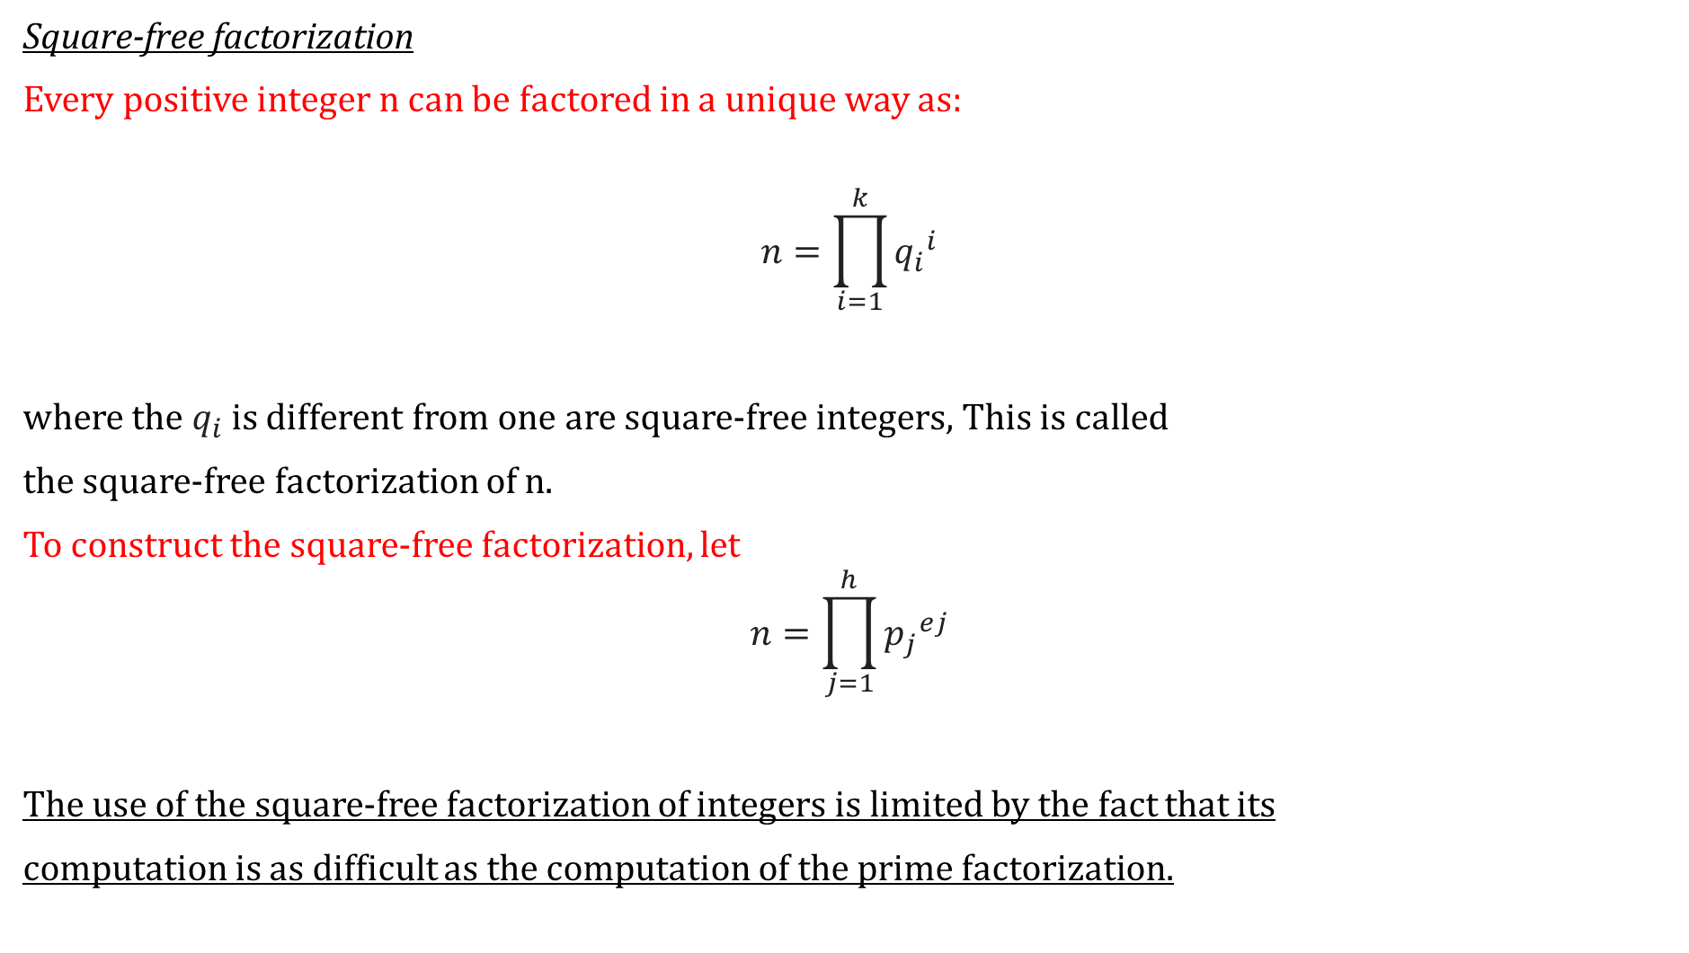
Square-free factorization
Every positive integer n can be factored in a unique way as:
$$n=\prod_{i=1}^{k}{{q_{i}}^{i}}$$
where the $q_{i}$ is different from one are square-free integers, This is called
the square-free factorization of n.
To construct the square-free factorization, let
$$n=\prod_{j=1}^{h}{{p_{j}}^{ej}}$$
The use of the square-free factorization of integers is limited by the fact that its
computation is as difficult as the computation of the prime factorization.

Slide 8
Mobius function
For any positive integer n, define μ(n) It has values in {−1, 0, 1}
depending on the factorization of n into prime factors:
μ(n) = +1 --> even number of prime factors.
μ(n) = −1 --> odd number of prime factors.
μ(n) = 0 --> if n has a squared prime factor.
Examples:
10 = 2 × 5 --> μ(10) = +1
17 --> μ(17) = −1
12 = 2² × 3 --> μ(12) = 0
A positive integer n is square-free if μ(n) ≠ 0.
all prime numbers are square-free integer.

Slide 9

Encoding as binary numbers
binary number with the encoding:
$$\sum_{n=0}^{\text{∞}}{{an . 2}^{n}}$$
Example 1:
If square-free number = 42
The factorization = 2 × 3 × 7 = 42
As infinite product = 2¹ · 3¹ · 5⁰ · 7¹ · 11⁰ · 13⁰……..
as the binary sequence = 110100
Since the prime factorization of every number is unique, so also is
every binary encoding of the square-free integers.

Slide 10
Example 2:
If square-free number = 70
The factorization = 2×5×7 = 70
As infinite product = 2¹ · 3⁰ · 5¹ · 7¹ · 11⁰ · 13⁰……..
as the binary sequence = 101100
Example 3:
If binary sequence= 010101
This decodes = 2⁰ · 3¹ · 5⁰ · 7¹ · 11⁰ · 13¹
The factorization = 3×7×13
unique square-free integer = 237

Slide 11
How to implement square free integer as a program code.
public boolean isSquareFree(int n) {
if(n%2==0) {
n=n/2;
if(n%2==0)
return false;
}
else {
for(int i=3; i<Math.sqrt(n); i+=2) {
if(n%i==0) {
n=n/i;
if(n%i==0)
return false;
}
}
}
return true;
}

Slide 12
Exercise.
Is the following numbers square free integer or not?
(1) :35?
(2): 12?

Slide 13
Exercise.
Is the following numbers square free integer or not?
(1) :35? Yes it is, because 35=5*7.
(2): 12?

Slide 14
Exercise.
Is the following numbers square free integer or not?
(1) :35? Yes, because 35=5*7.
(2): 12? Not, because 12=2^2*3.

Slide 15
References
https://en.wikipedia.org/wiki/Square-free_integer
Shapiro, Harold N. (1983). Introduction to the theory of numbers. Oxford University Press Dover Publications. ISBN 978-0-486-46669-9.
Granville, Andrew; Ramaré, Olivier (1996). "Explicit bounds on exponential sums and the scarcity of squarefree binomial coefficients". Mathematika. 43: 73–107. CiteSeerX 10.1.1.55.8. doi:10.1112/S0025579300011608. MR 1401709. Zbl 0868.11009.
Guy, Richard K. (2004). Unsolved problems in number theory (3rd ed.). Springer-Verlag. ISBN 978-0-387-20860-2. Zbl 1058.11001.
"OEIS Wiki". Retrieved 24 September 2021.

Slide 16
Thank you for watching

